Slide 1
Next Generation Javascript
#javascriptEverywhere

Slide 2
Outlines
Intoduction
What is ECMAScript
ES6 tools
let & const vs Var
Arrow Functions
Exports & Imports
Classes
Spread & Rest Operations
Destructuring
JS Array Functions

Slide 3
Introduction
The following materials requires Javascript
What is the meaning of new generation Javasripts
New functions and code
Feeling for a review please review this fast demonstration on Javascript https://www.youtube.com/watch?v=_y9oxzTGERs
What’s best than trying by your hand, check this crushing course on Codecademy: https://www.codecademy.com/learn/introduction-to-javascript
Notes:
This presentation will talk about the advanced feature that has been introduced to Javascript, and move it to a new generation
This presentation is require a basic understanding of Javascript, if you want a recap, check these out

Slide 4
What is ES
ES is short for ECMAScript
It’s a standardized for JavaScript
You might hear about ES6, ES7, ES8 the newest versions of ECMAScript
We will work focus on ES6
Notes:
- ECMAScript is basically a standard for script languages, therefore, Javascript was build on this standard. ECMA means European Computer Manufacturer’s Association
ES6 has provided the big step for javascript to move to an Object-Oriented language
As we now that every browser now has a JavaScript interpreter, that’s why platform from all over the worlds needed a common standard, that’s what ECMA has provided
- ES7, ES8 are basically adding up for ES6 like async methods or other, we will not consider them for current presentation

Slide 5
let & const vs Var
let keyword allows you to define variables considering the block scope
const keyword acts like final keyword in java.
var keyword on the otherhand considers the functional scope
Example
Let
https://jsbin.com/qozibuq/1/edit?js,console
Const
https://jsbin.com/jufelig/edit?js,console
Notes:
- let and const basically replace var . You use let instead of var and const instead of var if you plan on never re-assigning this "variable" (effectively turning it into a constant therefore). - The let statement declares a block scope local variable, optionally initializing it to a value.
- The Const It tells you that the variable that is defined as const will not be changed again in the entire code
- The Var it doesn’t care about the block scope. That means you can use var keyword to define global variables

Slide 6



Arrow Functions
Arrow functions must always return a value.
Unlike normal functions, you can use this code in the scope of arrow functions.
Notes:
Arrow functions are a different way of creating functions in JavaScript. Besides a shorter syntax, they offer advantages when it comes to keeping the scope of the this keyword
Figure1: Arrow function syntax may look strange but it's actually simple
Figure2: which you could also write as:
Figure3: becomes

Slide 7



Arrow Functions
No Arguments
One Argument
Exactly one Argument
Example:
https://jsbin.com/lozuwun/edit?js,console
Notes:
Importants
When having no arguments, you have to use empty parentheses in the function declaration:
When having exactly one argument, you may omit the parentheses
When just returning a value, you can use the following shortcut, that is equal to the each others

Slide 8
Export & Imports
Default =>
Named =>
You can import default exports like this
Named exports have to be imported by their name:
export default …;
export const someData = …;
import someNameOfYourChoice from ‘./path/to/file.js’;
import { someData } from ‘./path/to/file.js’;
Notes:
- In React projects (and actually in all modern JavaScript projects), you split your code across multiple JavaScript files - so-called modules. You do this, to keep each file/module focused and manageable. To still access functionality in another file, you need export (to make it available) and import (to get access) statements. You got two different types of exports: default (unnamed) and named exports:
Surprisingly someNameOfYourChoice is totally up to you
A file can only contain one default and an unlimited amount of named exports. You can also mix the one default with any amount of named exports in one and the same file

Slide 9
Export & Imports
Import all named exports
Example:
import * as upToYou from ‘./path/to/file.js’;
export const someData = ... (/path/to/file.js )
Notes:
When importing named exports, you can also import all named exports at once with the following syntax
upToYou is - well - up to you and simply bundles all exported variables/functions in one JavaScript object. For example,
if you export const someData = ... (/path/to/file.js ) you can access it on upToYou like this: upToYou.someData .

Slide 10
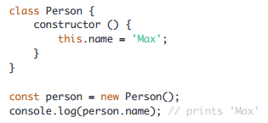
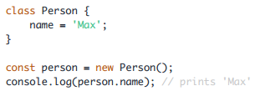
Classes
Object oriented class support
Example (using old Syntax):
Example (using new Syntax):
Notes:
Classes are a feature which basically replace constructor functions and prototypes. You can define blueprints for JavaScript objects with them
- In the above example, not only the class but also a property of that class (=> name ) is defined. They syntax you see there, is the "old" syntax for defining properties. In modern JavaScript projects (as the one used in this course), you can use the following, more convenient way of defining class properties:

Slide 11
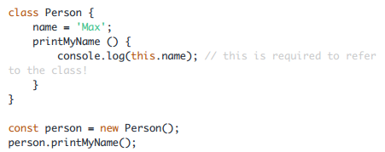
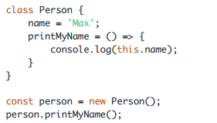
Classes
You can also define methods
Notes:
The second approach has the same advantage as all arrow functions have: The this keyword doesn't change its reference.

Slide 12
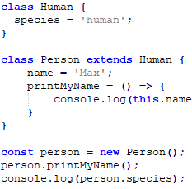
Classes
You can also use inheritance when using classes:

Slide 13

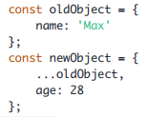
Spread & Rest Operator
The spread and rest operators actually use the same syntax
Using the Spread Operator – Example:
Here's the spread operator used on an object
…
Notes:
Yes, that is the operator - just three dots. It's usage determines whether you're using it as the spread or rest operator.
The spread operator allows you to pull elements out of an array (=> split the array into a list of its elements) or pull the properties out of an object. Here are two examples:

Slide 14

Spread & Rest Operator
New Object would then be:
The spread operator is extremely useful for cloning arrays and objects
Remember, they are both reference types (and not primitives)
Notes:
The spread operator is extremely useful for cloning arrays and objects . Since both are reference types (and not primitives), copying them safely (i.e. preventing future mutation of the copied original) can be tricky. With the spread operator you have an easy way of creating a (shallow!) clone of the object or array

Slide 15

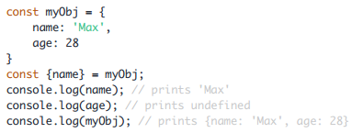
Destructuring
Destructuring allows you to easily access the values of arrays or objects and assign them to variables.
Example:
Array Object

Slide 16


Destructuring
Destructuring is very useful when working with function arguments.
Example:
By using Destructuring
Notes:
Here, we only want to print the name in the function but we pass a complete person object to the function. Of course this is no issue but it forces us to call personObj.name inside of our function
We get the same result as above but we save some code. By destructuring, we simply pull out the name property and store it in a variable/ argument named name which we then can use in the function body

Slide 17
JS Array Function
map
find
findIndex
filter
reduce
concat
slice
splice

Slide 18
Map
The map() method creates a new array with the results of calling a provided function on every element in the calling array.
Remember Arrows Functions in ES6 ?
Example
https://jsbin.com/rukitak/edit?js,console

Slide 19
Find
The find() method returns the value of the first element in the array that satisfies the provided testing function. Otherwise undefined is returned.
Example
https://jsbin.com/jewefim/edit?js,console

Slide 20
findIndex
The findIndex() method returns the index of the first element in the array that satisfies the provided testing function. Otherwise, it returns -1, indicating that no element passed the test.
Didn’t forget Arrow functions yet?, we are using it here too
Example:
https://jsbin.com/zazuboc/edit?js,console

Slide 21
Filter
The filter() method creates a new array with all elements that pass the test implemented by the provided function.
Example
https://jsbin.com/lucabat/1/edit?js,console

Slide 22
Reduce
The reduce() method executes a reducer function (that you provide) on each element of the array, resulting in a single output value.
reduce has 2 parameters
Accumlator
currentValue
Example:
https://jsbin.com/vixiyu/edit?js,console
Notes:
First parameter represents the source array of elements
Second parameter represents the value that we want to use the reduce on the source array for.

Slide 23
Concat
The concat() method is used to merge two or more arrays. This method does not change the existing arrays, but instead returns a new array.
Example
https://jsbin.com/siwuxef/edit?js,console

Slide 24
Slice
The slice() method returns a shallow copy of a portion of an array into a new array object selected from begin to end (end not included). The original array will not be modified.
Example:
https://jsbin.com/cuwijib/edit?js,console

Slide 25
Splice
The splice() method changes the contents of an array by removing or replacing existing elements and/or adding new elements in place.
Example:
Remove item
https://jsbin.com/piwixiv/edit?js,console
Remove with Insert
https://jsbin.com/nipumiq/edit?js,console

